Slide 1
NetApp FAS6210 Shared Low Tier Standard Architecture
Mike Arndt, Systems Engineer
2011-09-06

Slide 2
Overview
New Shared Low Tier Standard Architecture:
FAS6210 HA Pair
DS4243 shelves of 2TB 7.2k SATA drives
4 shelves in base configuration
6 shelves in maximum configuration (with 8.1)
512GB of FlashCache per controller
10GbE connectivity for data access
1GbE connectivity for management
Software licenses:
NFS, CIFS, and iSCSI protocols
SnapMirror, SnapVault, and SnapRestore
Multistore and Deduplication

Slide 3
Requirements and Limitations
The FAS62xx platform requires ONTAP 8.0.1 or higher
Standard ONTAP version will initially be 8.0.1P5
ONTAP 8.0.x does not support Online DataMotion for vFilers
Offline DataMotion for vFilers still supported
ONTAP 8.1 will support DataMotion for vFilers
Due to be GA by the end of CY2011
ONTAP 8.1 required for larger aggregates
70TB max aggr size with 8.0, 162TB max aggr size with 8.1
Adding 2 shelves to the 4 shelf base configuration requires 8.1 in order to still use 1 aggregate per controller
65 vFilers per controller continues to be the limit
5 meter limit as maximum distance from controllers to all disk shelves

Slide 4
Capacity and Performance Scaling
Base config of 4 shelves per cluster:
112TB usable
Maximum config of 6 shelves per cluster
170TB usable
Peak throughput at 32k 50/50 read/write mix:
637MB/sec per controller
20,400 IOPs per controller
Peak IOPs at 4k 50/50 read/write mix:
42,750 IOPs per controller
166MB/sec per controller
Performance profile limits:
7.5MB/sec per TB
503 IOPs per TB
These values assume possible performance degradation during a cluster failover event

Slide 5
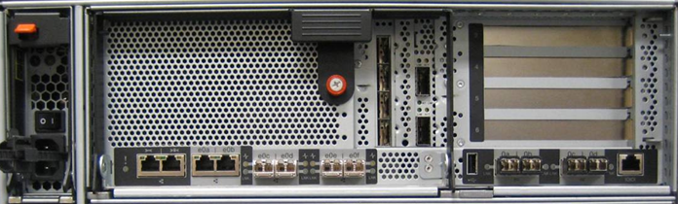
FAS/V6200 Controller I/O Standalone Controller
PCIe v2.0
Slots
GbE
NVRAM8
(Slot 2)
USB
(disabled)
e0a, e0b
Vertical I/O
Slot 1
Slots 3,4,5,6
e0M / SP
e0c, e0d, e0e, e0f
0a, 0b, 0c, 0d
Serial
Console
Management
ACP
10GbE
8Gb FC
10/100 Ethernet

Slide 6
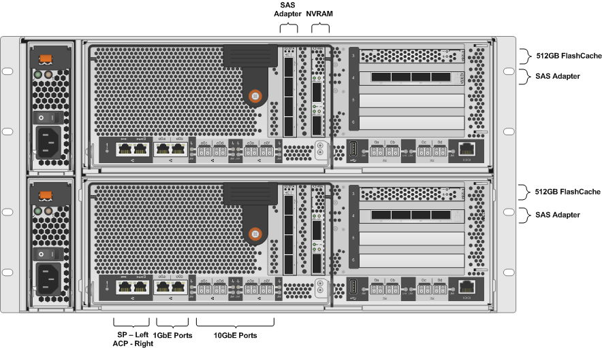
Controller Configuration Details

Slide 7
SAS Connectivity Details
Cable shelf to shelf IOMs from OUT ● to IN ■
A stack shelf IDs start with 00 and count up
B stack shelf IDs start with 10 and count up

Slide 8
ACP Connectivity Details
Cable shelf to shelf ACPs from OUT ● to IN ■
Use locked wrench port on FAS6210 for ACP connections

Slide 9
Network Connectivity Details
The SP (new version of the RLM) is the wrench port on the FAS6210
The locked wrench port on the FAS6210 is used for ACP connectivity to the shelves
The e0a 1GbE port is used for management network connectivity
This should be a 1GbE connection, not 100Mb
The e0c and e0e 10GbE ports should be used to create a LACP “ifgrp” for data access
An ifgrp is the 8.x equivalent of a vif in 7.x
The e0d and e0f 10GbE ports are used to create a 2nd LACP ifgrp as required

Slide 10
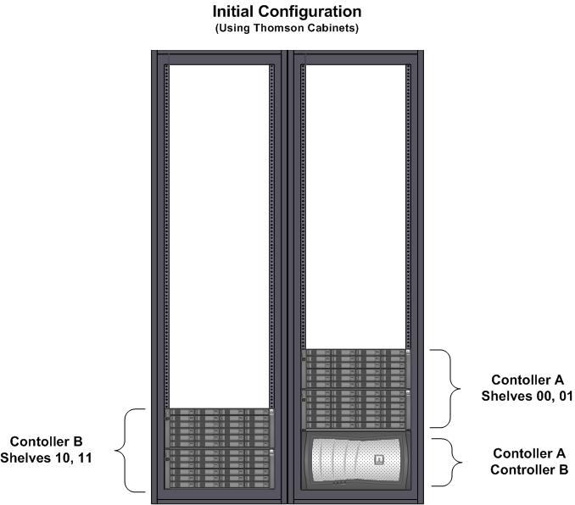
Initial Cabinet Layout

Slide 11
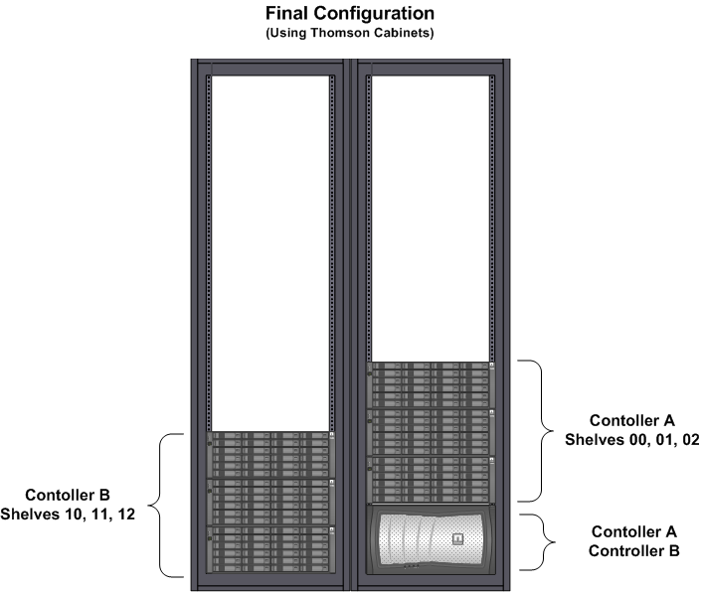
Final Cabinet Layout

Slide 12
Aggregate Sizing and Growth
ONTAP VERSION | ONTAP 8.0.1P5 or higher
AGGREGATE CONFIGURATION | 1 64bit aggregate per controller Aggregate snap reserve set to 0 and aggregate snapshots disabled Note: vol0 will reside on the data aggregate
RAID GROUP SIZE | 15 drives per raid group Note: aggregates should be grown in 9 or 15 drive increments
INITIAL CONFIGURATION 2 DS4243 shelves per controller 4 DS4243 shelves total | 1 aggregate of 3 raid groups (45 drives) per controller 3 spare drives per controller 56TB usable per controller = 112TB total
ONTAP VERSION | ONTAP 8.1 or higher
MAX SIZE WITH GROWTH 3 DS4243 shelves per controller 6 DS4243 shelves total | 1 aggregate of 4.5 raid groups (69 drives) per controller 3 spare drives per controller 85TB usable per controller = 170TB total

Slide 13
Dedication Solution Considerations
Some dedicated storage systems may have a similar configuration as the Shared Low Tier
Deviations from the Shared Low Tier platform that are acceptable include:
Installation in a single cabinet based on a known capacity growth maximum
Fewer protocols licensed, as most dedicated storage controllers do not require CIFS and iSCSI

